Slide 1

COMPUTER NETWORKS
(BCSC 0008)
Copyright content, use only with the written permission of presenter mentioned
Lecture 5

Slide 2
Transmission Media

Slide 3
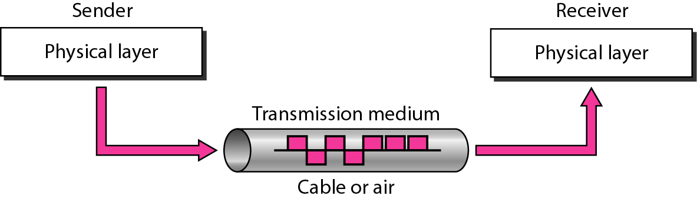
Figure 1 Transmission medium and physical layer

Slide 4
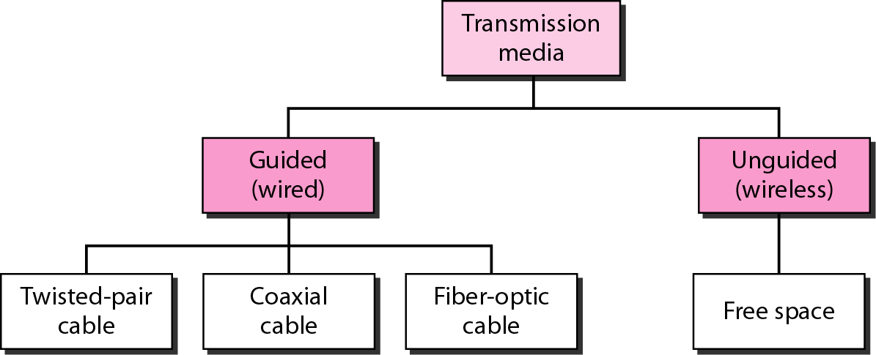
Figure 2 Classes of transmission media

Slide 5
GUIDED MEDIA
Guided media, which are those that provide a conduit from one device to another, include twisted-pair cable, coaxial cable, and fiber-optic cable. A signal traveling along any of these media is directed and contained by the physical limits of the medium. Twisted-pair and coaxial cable use metallic (copper) conductors that accept and transport signals in the form of electric current. Optical fiber is a cable that accepts and transports signals in the form of light.
Factors to be considered:
Cost
Transmission rate
Resistance
distance

Slide 6
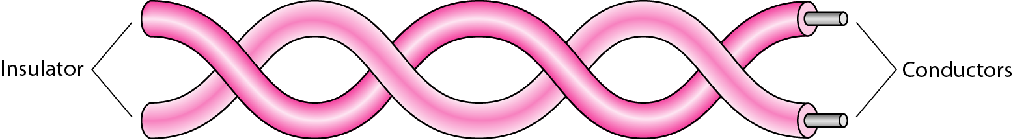
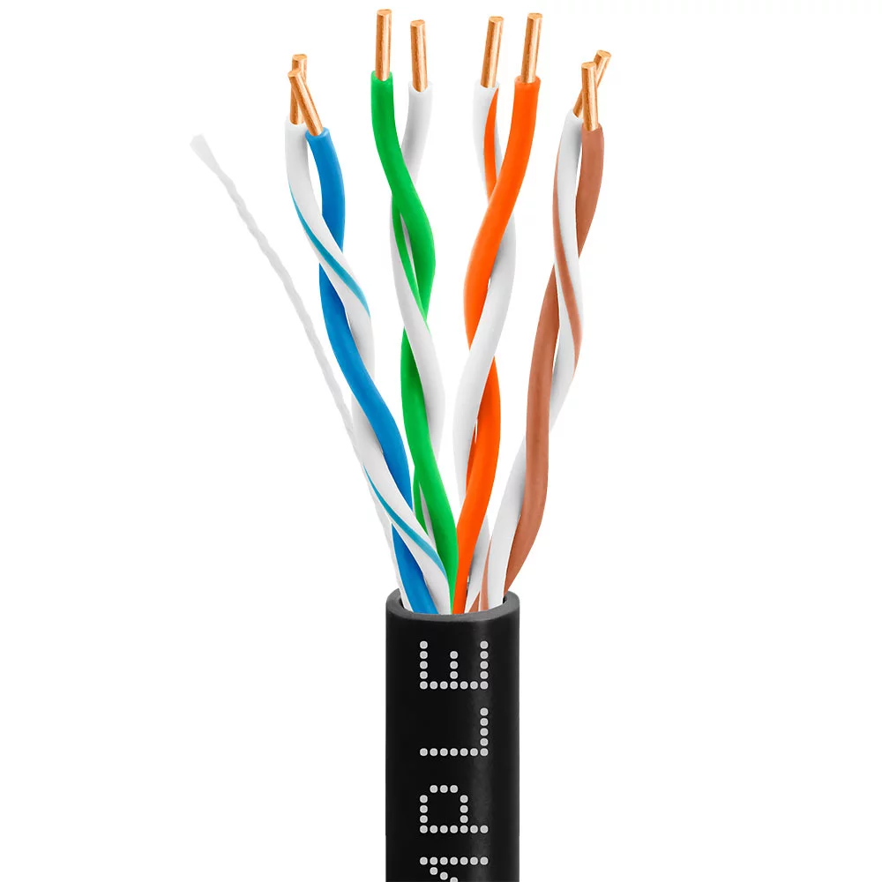
Figure 3 Twisted-pair cable
A twisted pair consists of two conductors (normally copper), each with its own plastic insulation, twisted together, as shown in Figure 3.

Slide 7
Twisted-pair cable
It is a pair of copper wires
Copper wires are used for transmitting the signals because of their good performance at low costs.
A twisted pair consists of two conductors (normally copper), each with its own plastic insulation, twisted together to form a single media
One of the wires is used to carry signals to the receiver, and the other is used only as a ground reference.
The twist between wires are helpful to reduce the noise (electromagnetic interference).
This type of cable is used in telephone lines to provide voice and data channels.

Slide 8
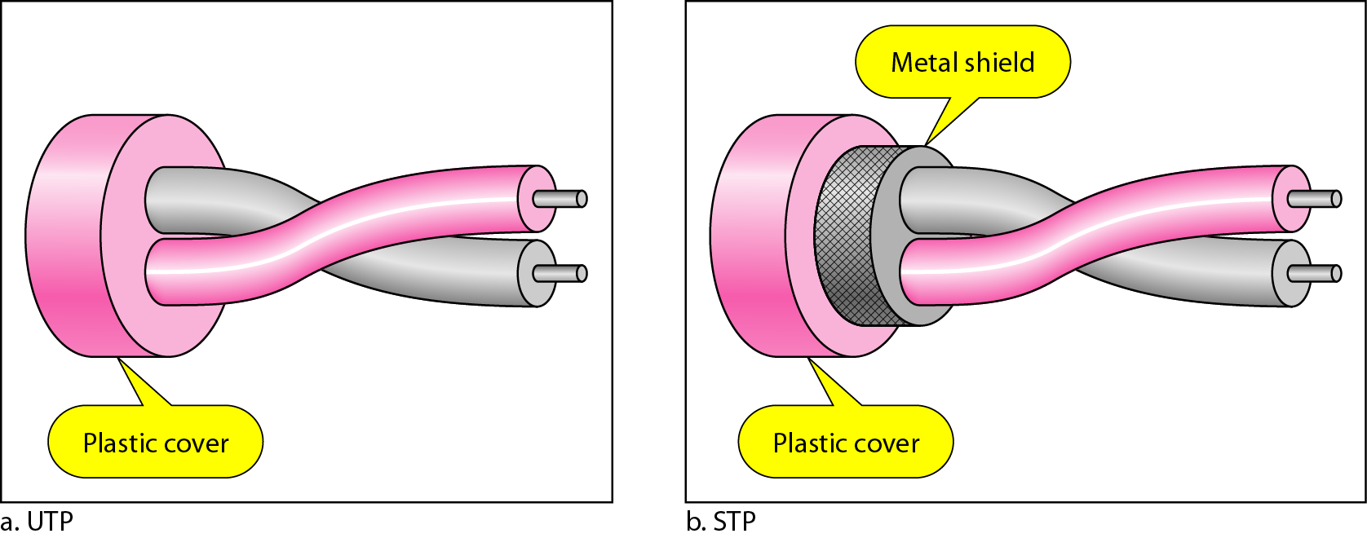
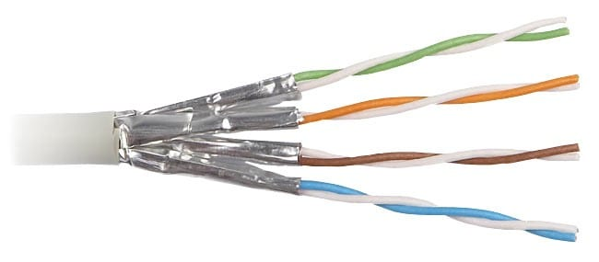
Figure 4 UTP and STP cables

Slide 9
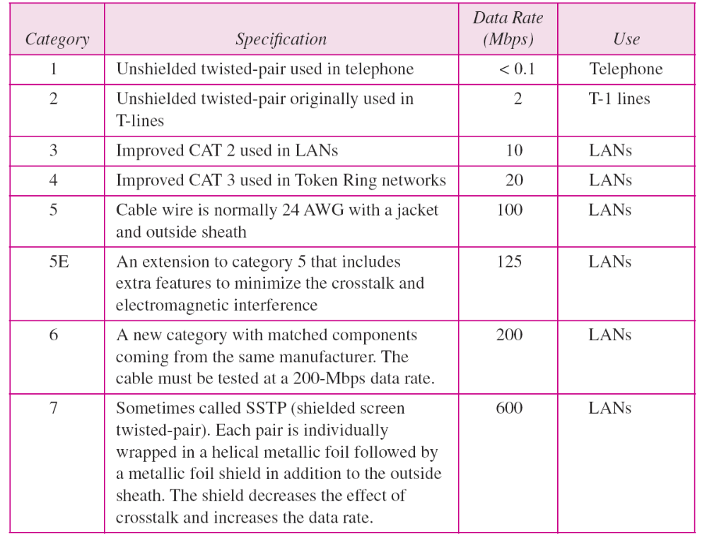
Table 7.1 Categories of unshielded twisted-pair cables

Slide 10
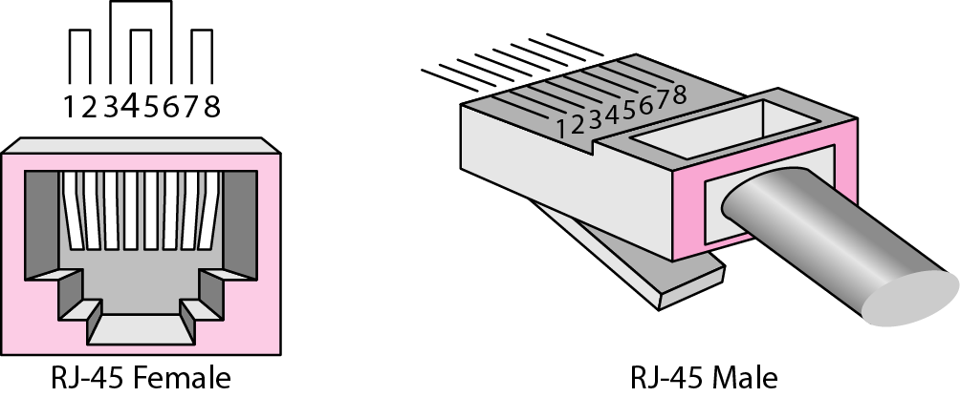
Figure 5 UTP connector

Slide 11
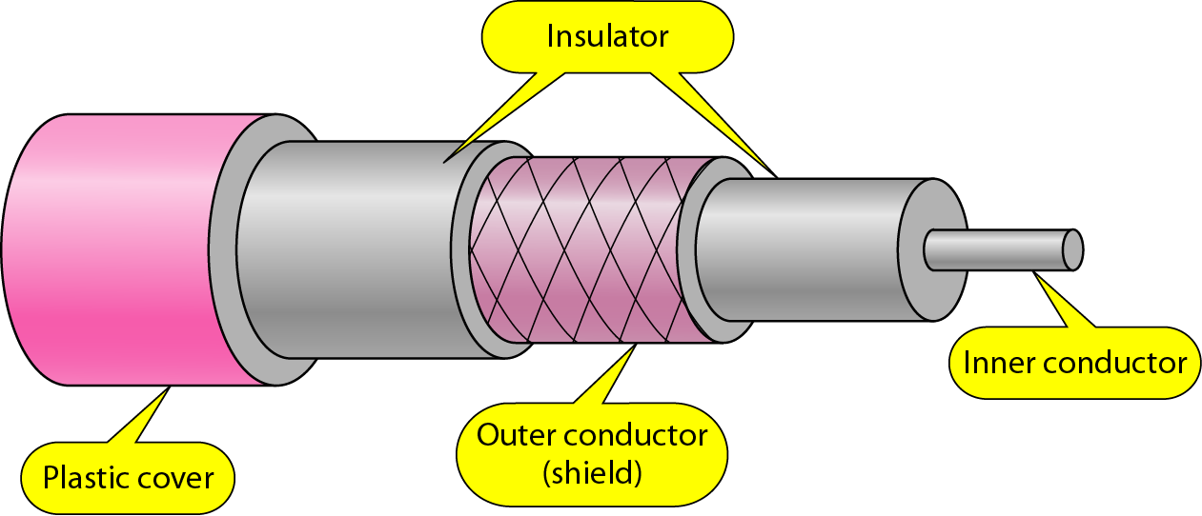
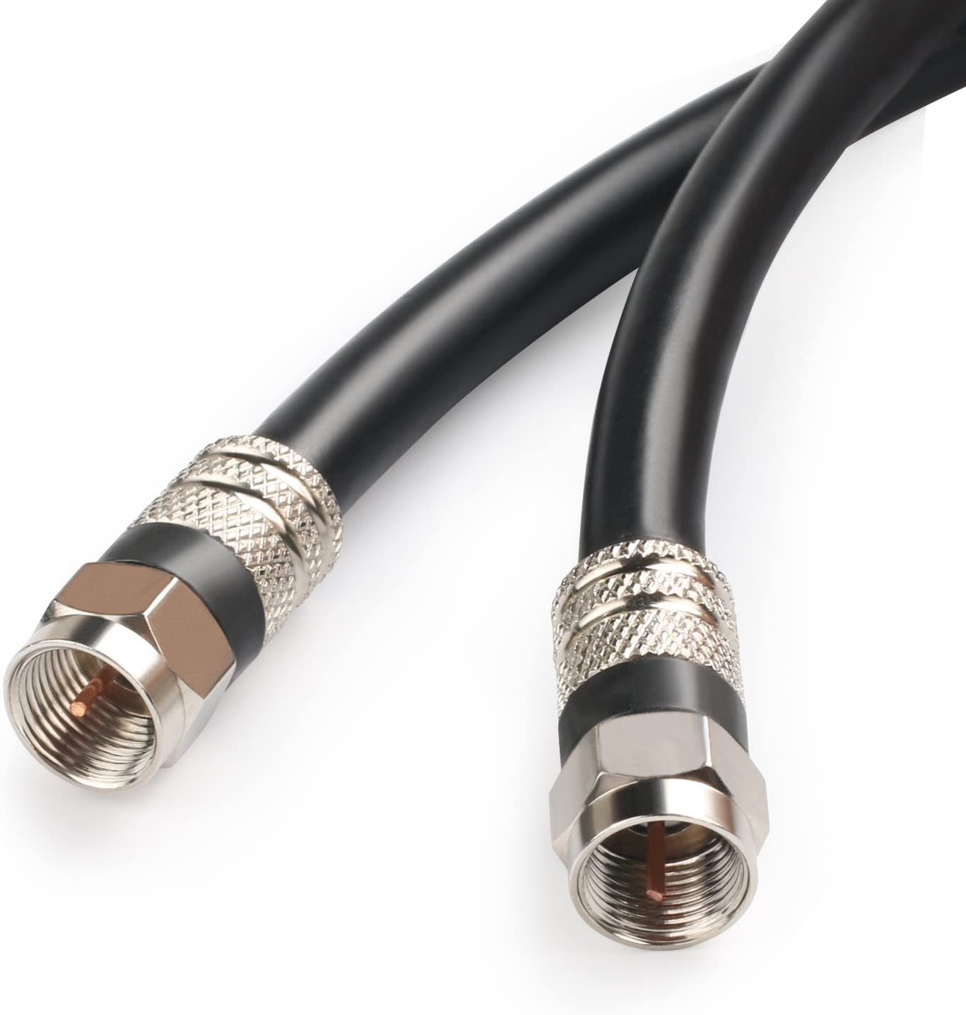
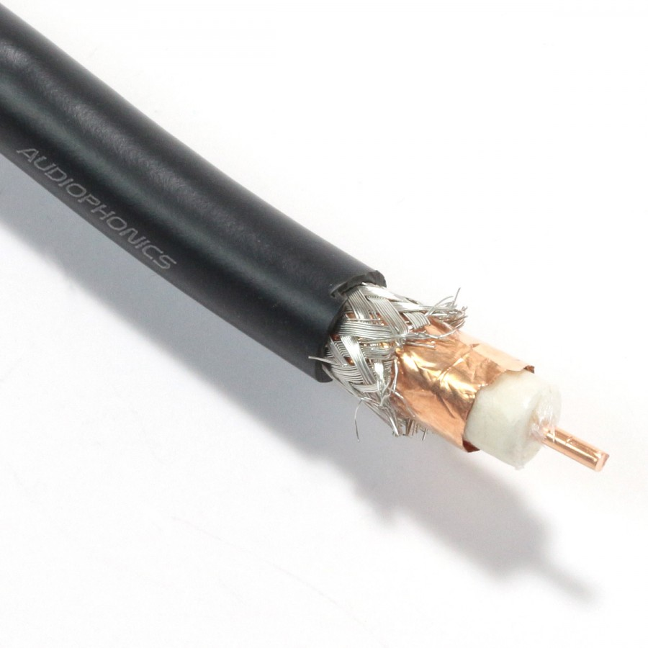
Figure 7 Coaxial cable

Slide 12
Coaxial cable
Coaxial cables are copper cables with better shielding than twisted pair cables, so that transmitted signals may travel longer distances at higher speeds.
This shield minimized the electrical and radio frequency interference.
It is a primary type of cabling used by the cable telephone industry and is also used by the computer networks such as Ethernet.
It has two wires of copper
The inner copper wire in the center and is made of a solid conductor. It is enclosed in an insulating sheath.
The outer copper wire is wrapped around and is used to protect from EMI (noise)
This all is covered by plastic cover used to protect the inner layers from physical damage such as fire or water.

Slide 13
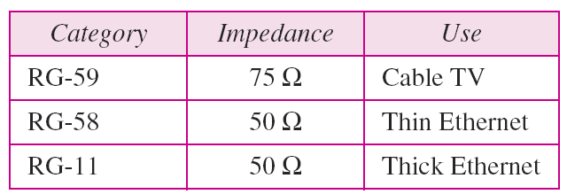
Table 7.2 Categories of coaxial cables

Slide 14
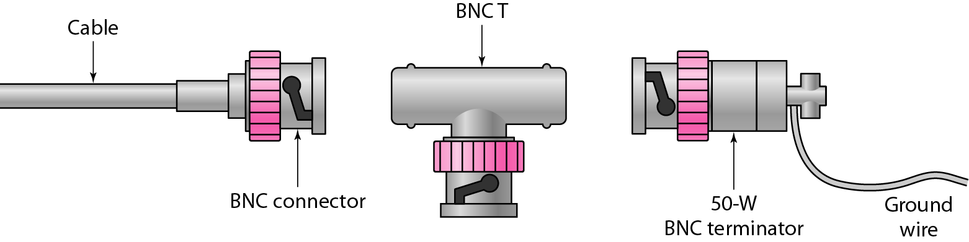
Figure 7.8 BNC (Bayone Neill Concelman) connectors
Figure 7.8 shows three popular types of these connectors: the BNC connector, the BNC T connector, and the BNC terminator. The BNC connector is used to connect the end of the cable to a device, such as a TV set. The BNC T connector is used in Ethernet networks to branch out to a connection to a computer or other device. The BNC terminator is used at the end of the cable to prevent the reflection of the signal.

Slide 15
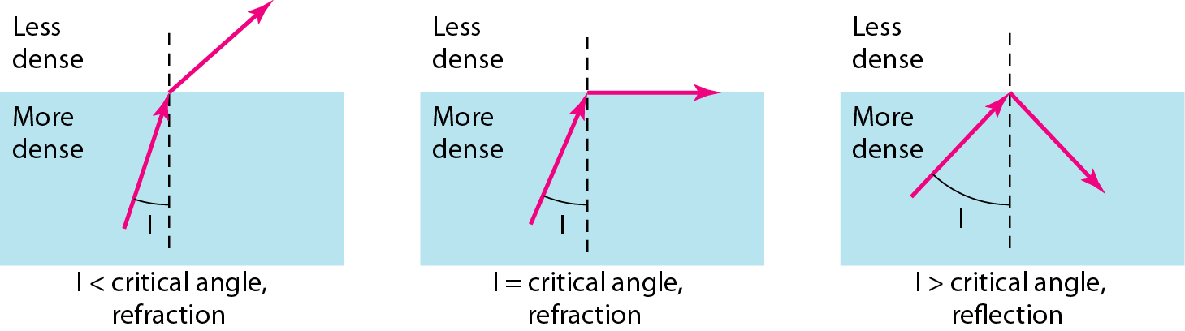
Fiber optics: Bending of light ray

Slide 16
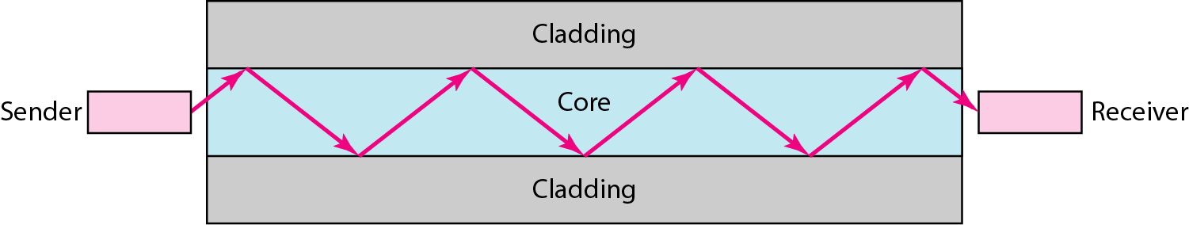
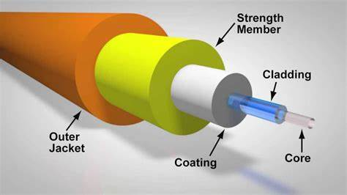
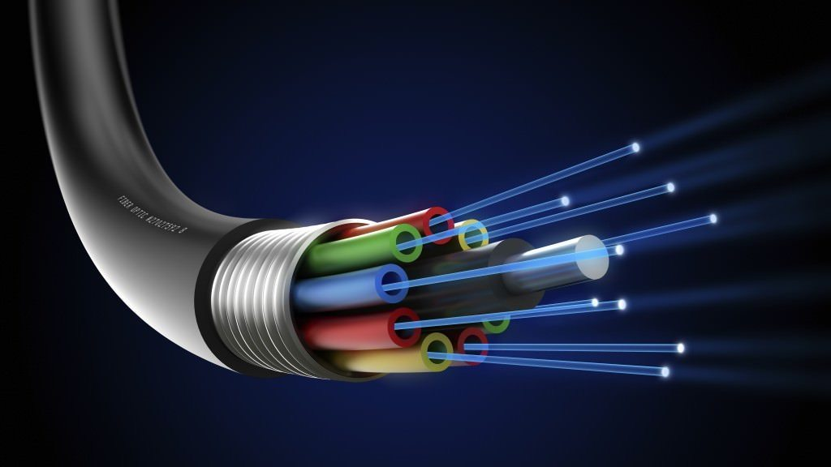
Figure Optical fiber

Slide 17
Optical fiber
A fiber-optic cable is made of glass or plastic and transmits signals in the form of light up to a distance of thousands of miles.
Fiber optical cables are not affected by EMI, so noise or distortion is very less.
The cable consists of one or more strands of glass, each only slightly thicker than a human hair. The center of each strand is called the core which provides the pathway for light to travel. The core is surrounded by a layer of glass called cladding that reflects light inward to avoid loss of signal and allow the light to pass through bends in the cable. No light escapes the glass core because of this reflective cladding

Slide 18
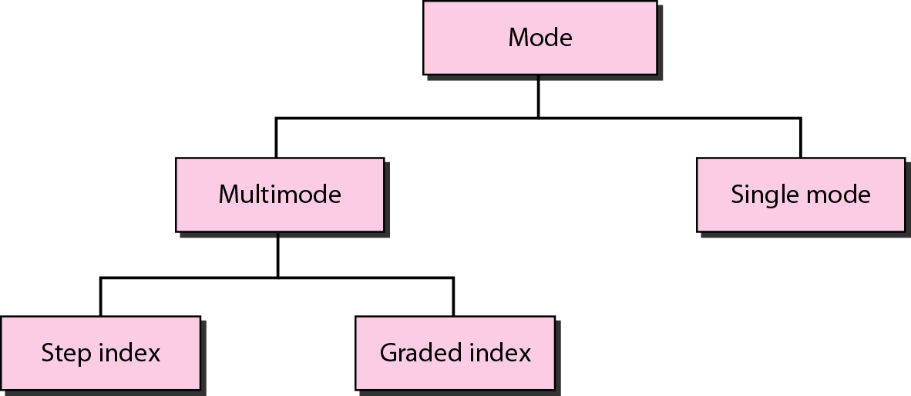
Figure Propagation modes
One light wave pass at a time
Multiple light waves can pass at a time

Slide 19
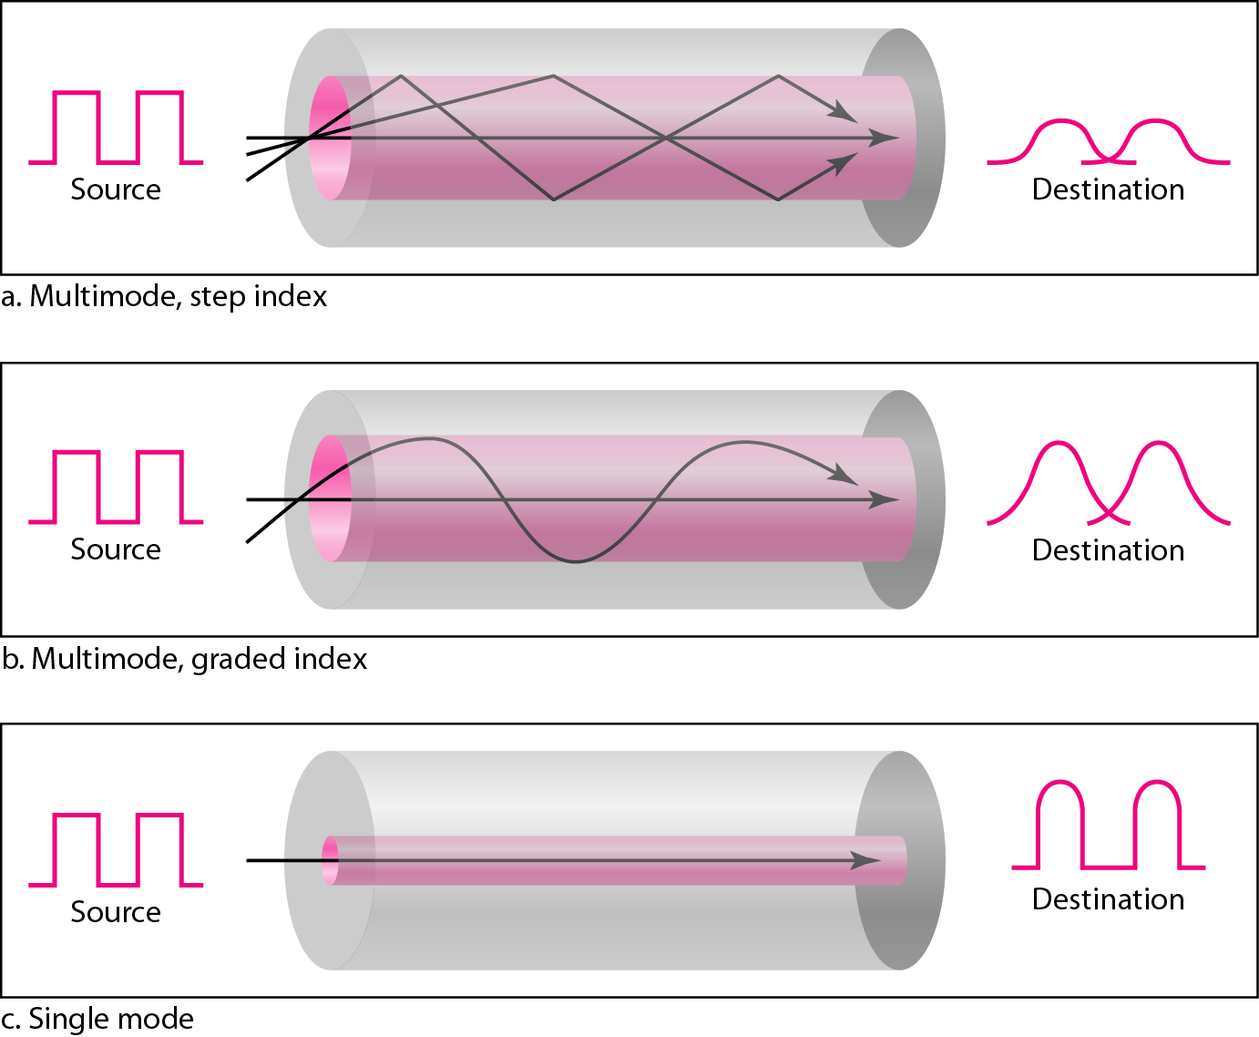
Figure 7.13 Modes
The density of the core remains constant from the center to the edges
It is one with varying densities. Density is highest at the center of the core and decreases gradually to the lowest of the edge.
Single mode used step-index fiber and a highly focused source of light that limits beams to a small range of angles, all close to horizontal

Slide 20
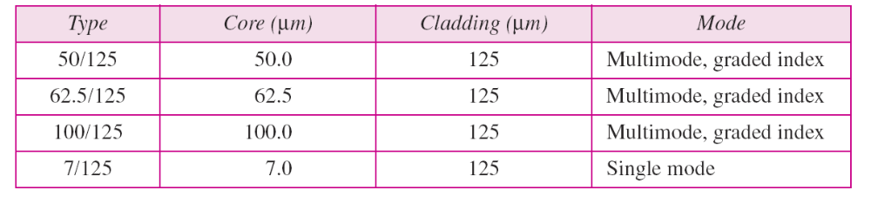
Table 7.3 Fiber types

Slide 21
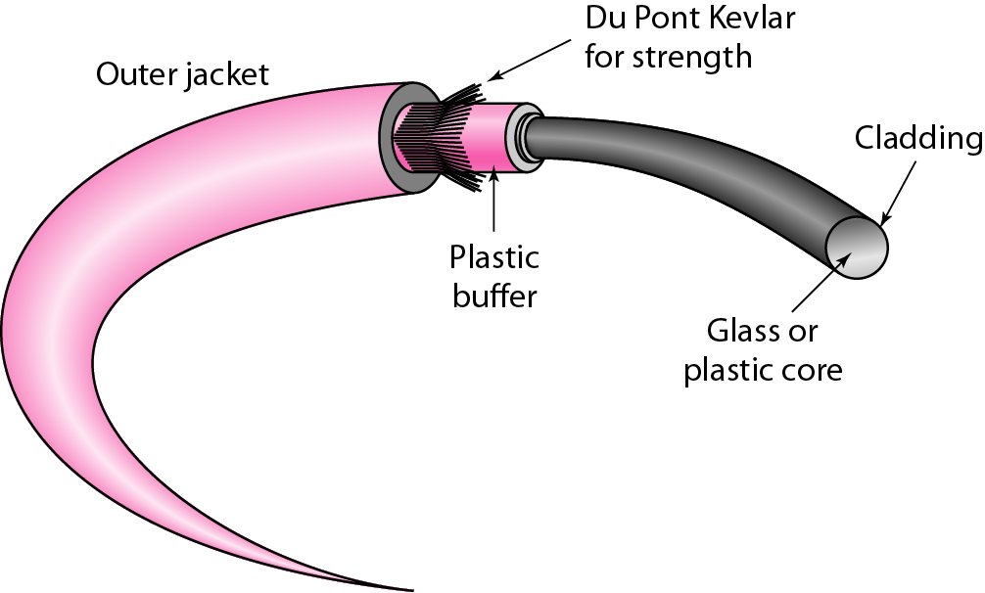
Figure 7.14 Fiber construction

Slide 22
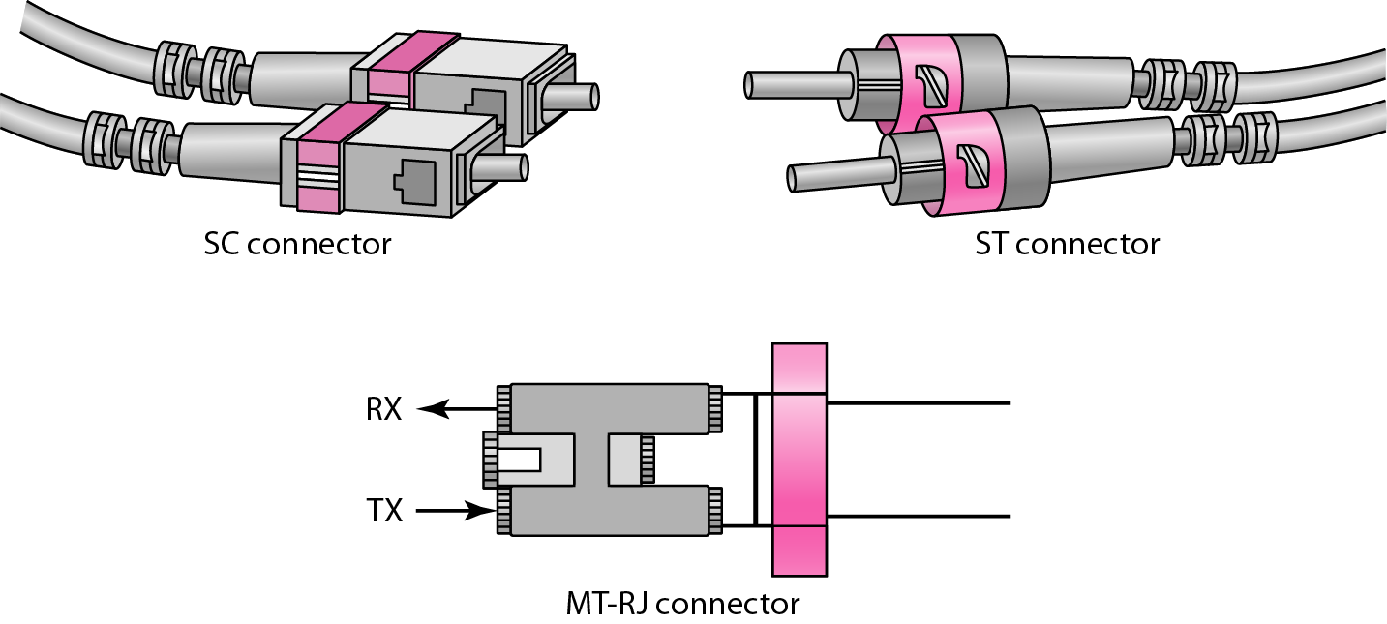
Figure Fiber-optic cable connectors

Slide 23
UNGUIDED MEDIA: WIRELESS
Unguided media transport electromagnetic waves without using a physical conductor. This type of communication is often referred to as wireless communication.
Topics discussed in this section:
Radio Waves
Microwaves
Infrared

Slide 24
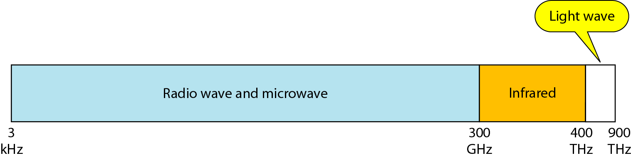
Figure 7.17 Electromagnetic spectrum for wireless communication

Slide 25
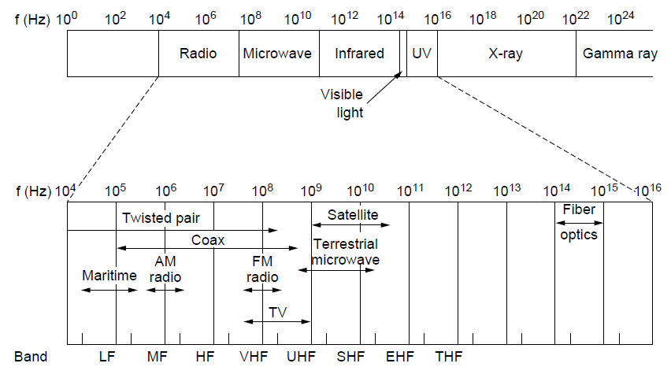
The Electromagnetic Spectrum (1)
The electromagnetic spectrum and
its uses for communication

Slide 26
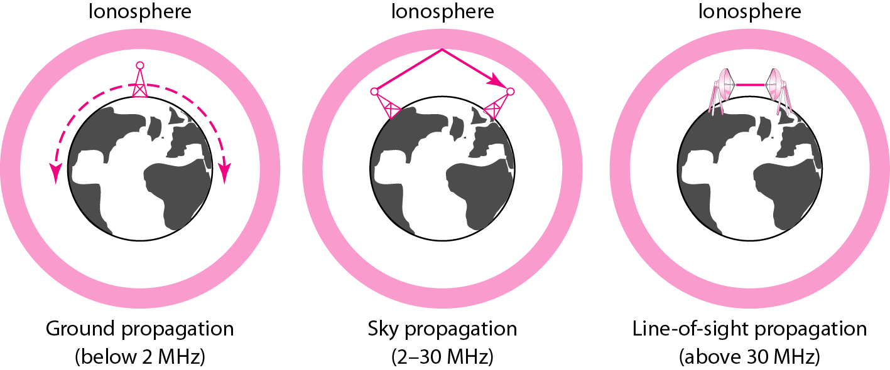
Figure Propagation methods

Slide 27
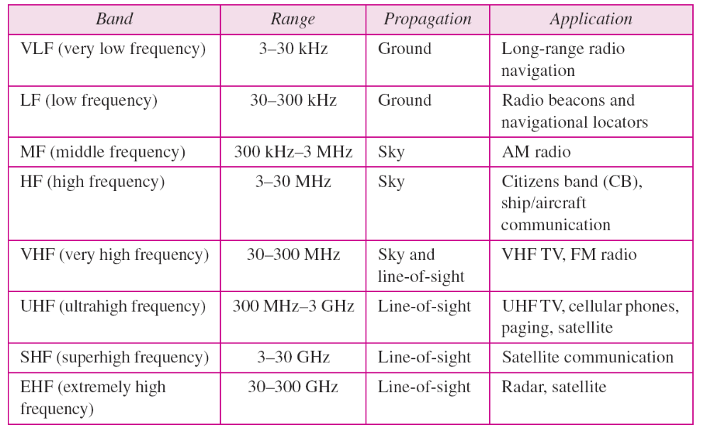
Table 7.4 Bands

Slide 28
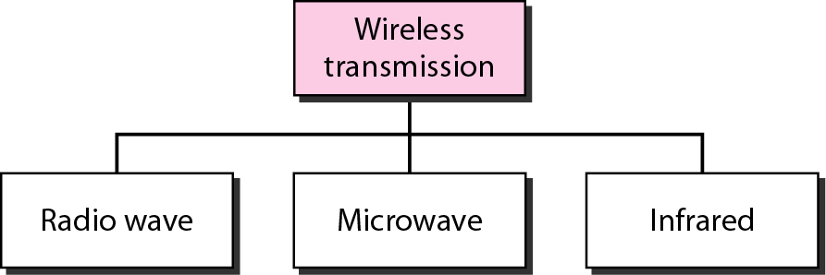
Figure 7.19 Wireless transmission waves

Slide 29

Note
Radio waves are used for multicast communications, such as radio and television, and paging systems. They can penetrate through walls.
Highly regulated. Use omni directional antennas

Slide 30
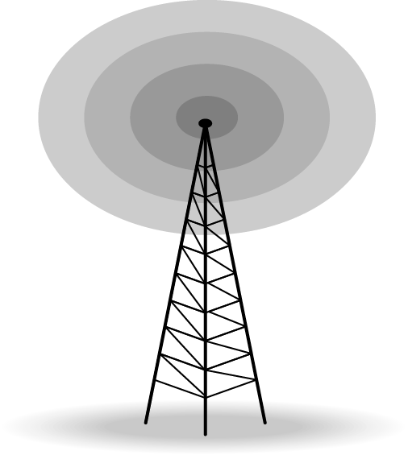
Figure Omnidirectional antenna

Slide 31
Note
Microwaves are used for unicast communication such as cellular telephones, satellite networks,
and wireless LANs.
Higher frequency ranges cannot penetrate walls.
Use directional antennas - point to point line of sight communications.

Slide 32
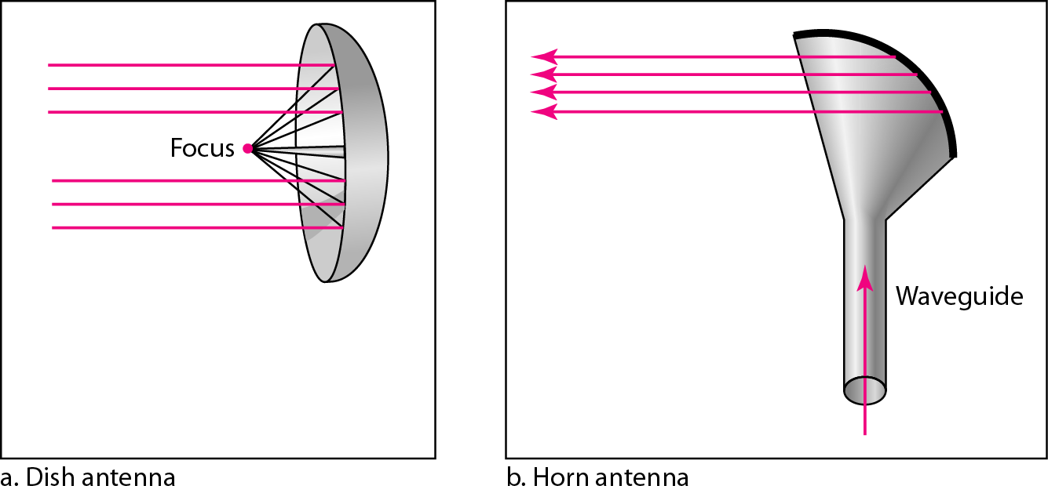
Figure 7.21 Unidirectional antennas

Slide 33
Note
Infrared signals can be used for short-range communication in a closed area using line-of-sight propagation.

Slide 34
Wireless Channels
Are subject to a lot more errors than guided media channels.
Interference is one cause for errors, can be circumvented with high SNR.
The higher the SNR the less capacity is available for transmission due to the broadcast nature of the channel.
Channel also subject to fading and no coverage holes.

